Slide 1

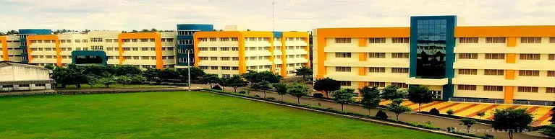
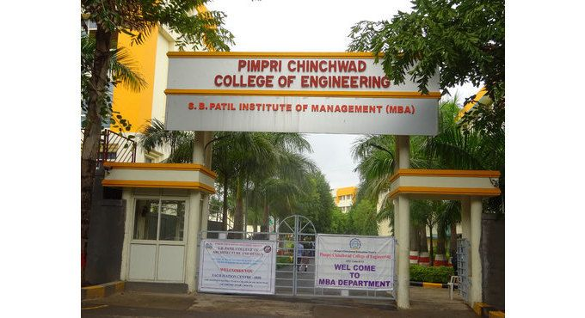
Pimpri Chinchwad College of Engineering
Title: Web Application for Google
Scholar Data Extraction
Prepared by:
Pratham Mali SYAIMLA39
Prathmesh Mohite SYAIMLA42
Pankaj More SYAIMLA43
Harsh Vahal SYAIMLA68
Guided by:
Pallavi Dhade

Slide 2

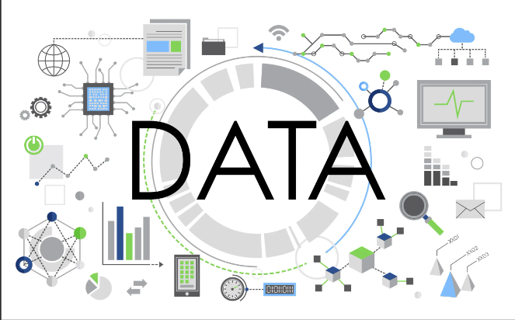

Problem Statement
The faculty at the college often need to manually gather data on other faculty members during College accreditation and reviews. This is a time-consuming and tedious task, as the data is spread across various sources and formats. The lack of an automated and streamlined process to fetch and consolidate this faculty data causes significant overhead for the professors, hindering their ability to focus on their core teaching and research responsibilities.

Slide 3
Technologies
Web Scraping (Scholarly Library): The Scholarly library is a Python tool used for scraping Google Scholar profiles. It allows you to extract data related to academic publications, citations, and author information from Google Scholar pages. This library is particularly useful when you need to gather data for faculty members, such as their research papers, citation counts, and academic impact.
Flask (Backend Framework): Flask is a lightweight web framework for Python. It’s used to build the backend of your application, handling HTTP requests, routing, and serving the application. Flask is simple and flexible, making it a great choice for small to medium-sized applications.

Slide 4
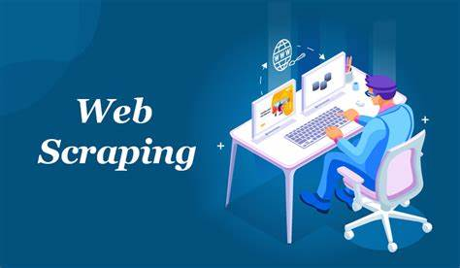

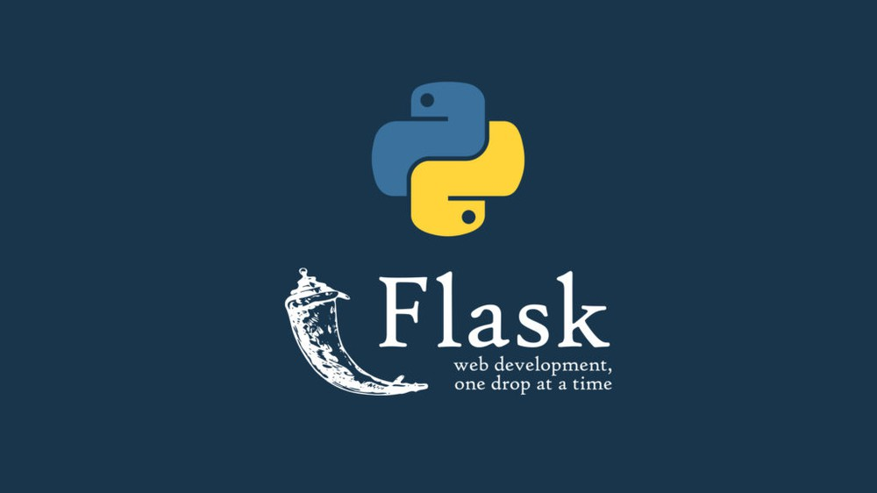
Technologies
MongoDB (Database): MongoDB is a NoSQL database that stores data in a flexible, JSON-like format called BSON (Binary JSON). This type of database is ideal when your data structure is dynamic or when you don’t need to strictly enforce a relational schema.

Slide 5
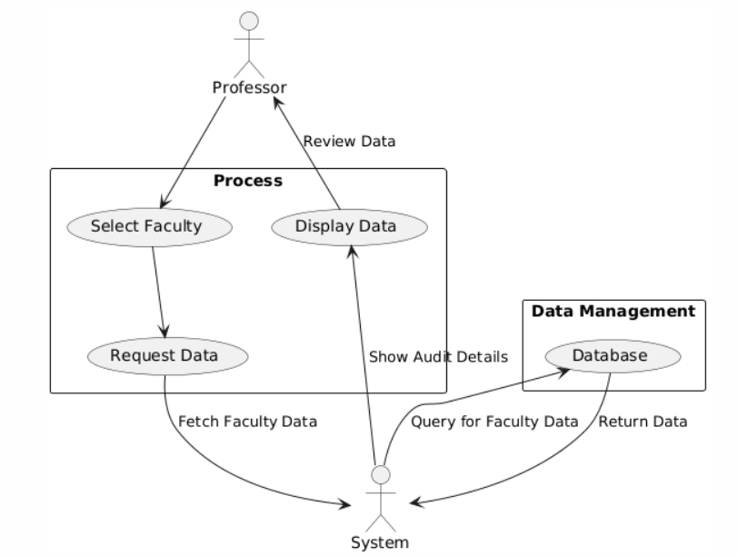
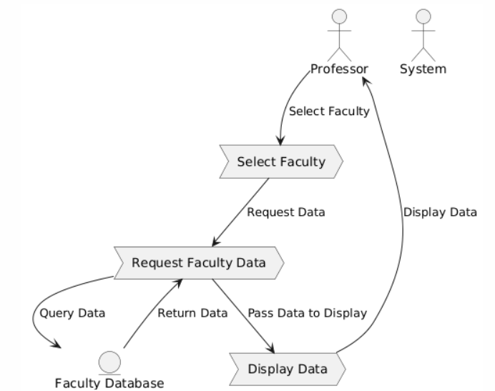
Data flow Diagram
Workflow diagram

Slide 6
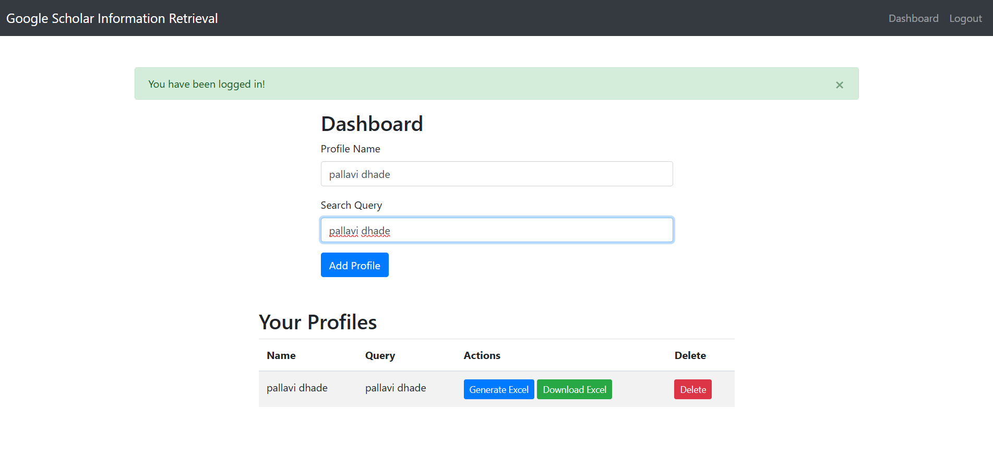
# Screenshots

Slide 7
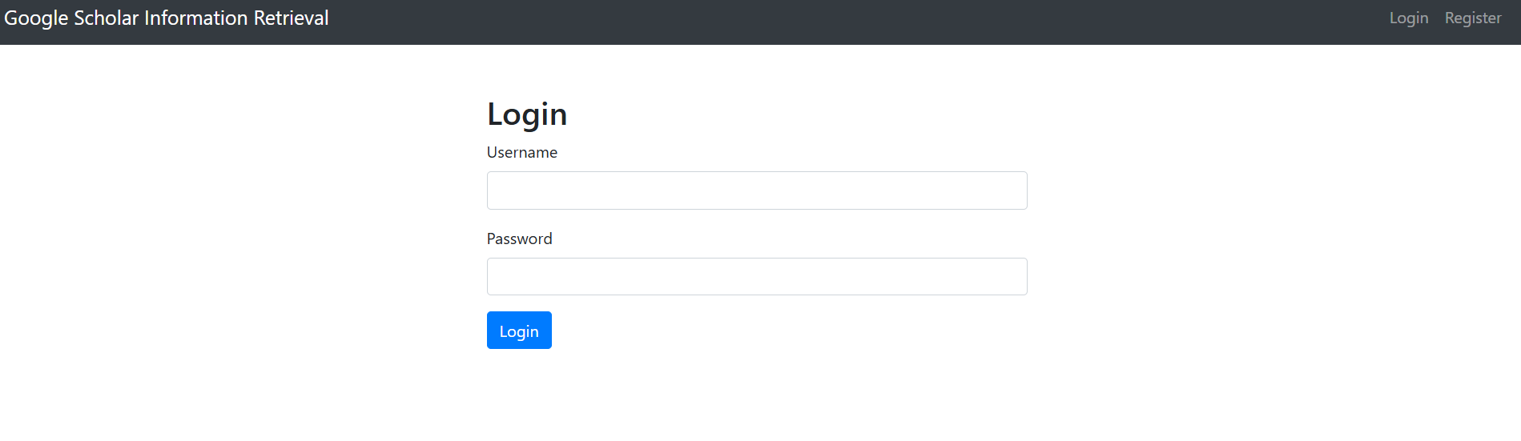
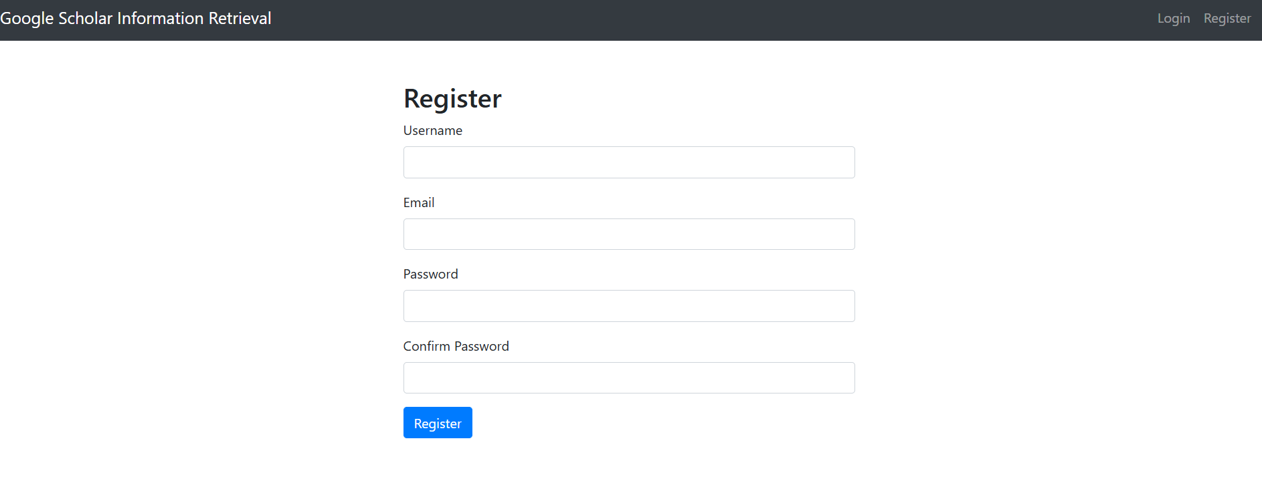

Slide 8

Challenges
Web Scraping Limitations: Legal and technical barriers such as rate-limiting,CAPTCHAs, and website structure changes.
Handling Concurrent Requests: Efficiently managing multiple requests without
overloading the server or causing delays.
Data Consistency: Ensuring accurate and up-to-date data extraction
amidst dynamic website content.
User Interface (UI) Design: Creating an intuitive, responsive, and smooth UI for seamless user interaction.

Slide 9

Conclusion
This project automates the faculty auditing process using Flask, MongoDB, and Scholarly for web scraping. The frontend is built with HTML, CSS, and JavaScript.The project offers a streamlined solution for professors, making data collection more efficient and user-friendly.

Slide 10
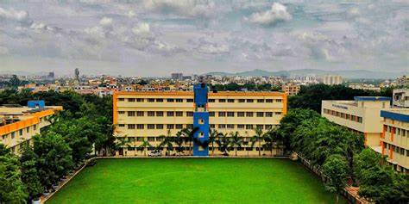
Thank You

